Slide 1
Pneumonia detection on chest x-ray
Sanjay Mahto

Slide 2
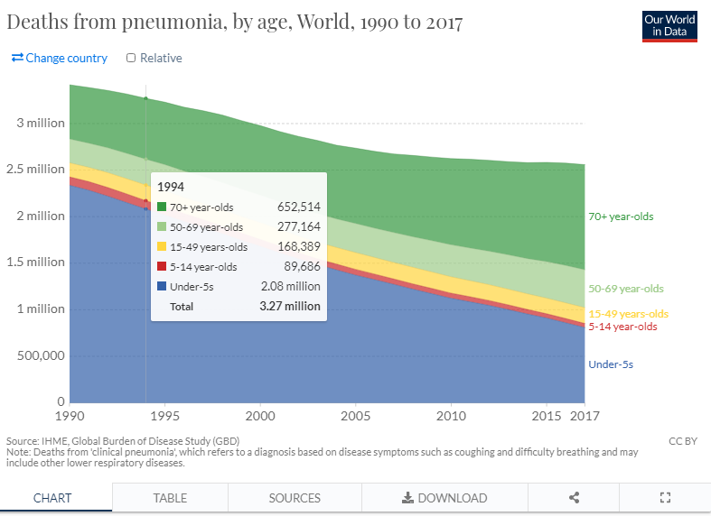
Background
Pneumonia is one of the most common symptom of the covid-19
Yearly it claims about 3 million death world wide.

Slide 3
Problem Statement
In This project we are trying to identify the pneumonia from the chest x-ray. As the pneumonia patients are all time high during these days have a assistance foe the medial practitioner to detect the pneumonia is the aim of this project

Slide 4
Data Wrangling
Data acquired from Kagles
Consists over 6 thousand chest x-ray
Data has been categorized in 2 category. Normal and Pneumonia
Training data has been used for building the model
Reshaping, Normalization and random data generation is used to stop the model from over fitting.

Slide 5
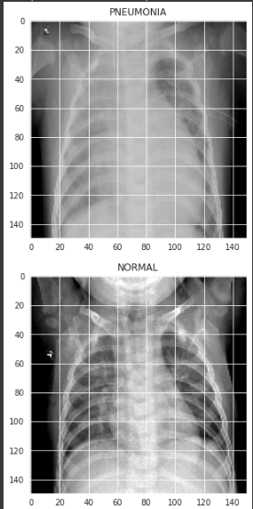
Data Exploration
Data has been labeled with respective category
The sample data of each category is visualized

Slide 6
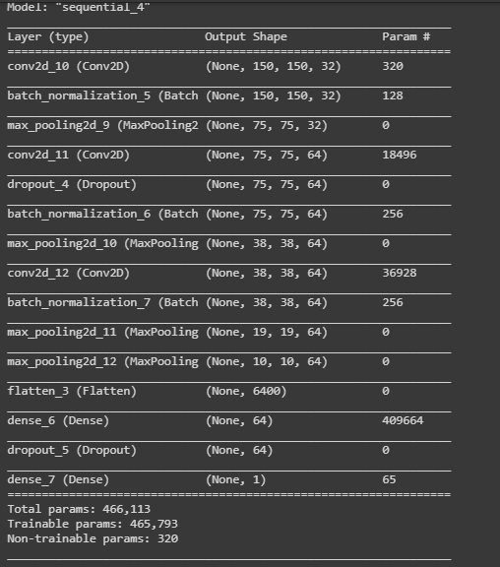
Modeling
CNN model with 2 hidden layers is used as a model for this project
The model summary as been shown here

Slide 7
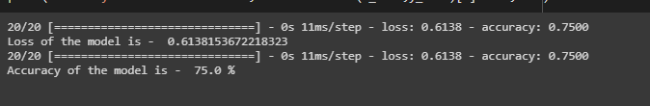
Results
The CNN model with two hidden layers is performing good
The result of the model is 75%
Rmsprop is used for the model optimization

Slide 8
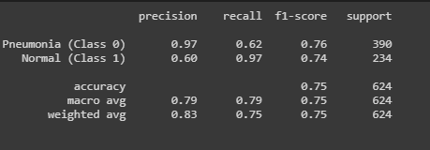
Accuracy Matrix
The detection of TP and TN is 97 % and FP and FN is around 60%

Slide 9
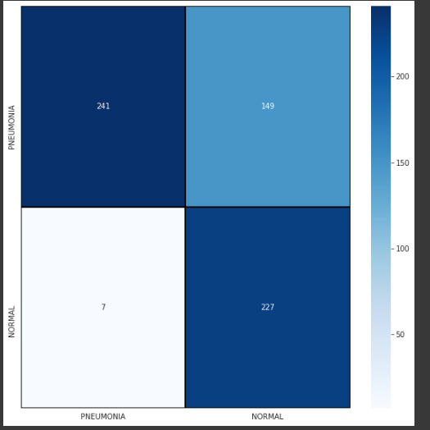
Confusion Matrix
Heat map of the confusion matrix has been shown below

Slide 10
Conclusion
CNN model with two hidden layer is performing well with 75% accuracy.
Model can developed further by adding more layer which may yield better results
It can be deployed as web application to detect pneumonia from any chest x-ray uploaded

Slide 11
Thank you

